Slide 1
Python Programming Language

Slide 2
Books include:
Learning Python by Mark Lutz
Python Essential Reference by David Beazley
Python Cookbook, ed. by Martelli, Ravenscroft and Ascher
(online at http://code.activestate.com/recipes/langs/pyt hon/)
http://wiki.python.org/moin/PythonBooks

Slide 3
4 Major Versions of Python
“Python” or “CPython” is written in C/C++
Version 2.7 came out in mid-2010
Version 3.1.2 came out in early 2010
“Jython” is written in Java for the JVM
“IronPython” is written in C# for the .Net environment

Slide 4
Contd…
Created in 1989 by Guido Van Rossum
Python 1.0 released in 1994
Python 2.0 released in 2000
Python 3.0 released in 2008
Python 2.7 is the recommended version
3.0 adoption will take a few years

Slide 5
Development Environments IDE
PyDev with Eclipse
Komodo
Emacs
Vim
TextMate
Gedit
Idle
PIDA (Linux)(VIM Based)
NotePad++ (Windows) 10.Pycharm

Slide 6
Web Frameworks
Django
Flask
Pylons
TurboGears
Zope
Grok

Slide 7
Introduction
Multi-purpose (Web, GUI, Scripting, etc.)
Object Oriented
Interpreted
Strongly typed and Dynamically typed
Focus on readability and productivity

Slide 8
Python features
no compiling or linking
rapid development cycle
no type declarations
simpler, shorter, more flexible
automatic memory management
garbage collection
high-level data types and operations

Slide 9
Contd..
fast development
object-oriented programming
code structuring and reuse, C++
embedding and extending in C
mixed language systems
classes, modules, exceptions,multithreading
"programming-in-the-large" support

Slide 10
Uses of Python
shell tools
system admin tools, command line programs
extension-language work
rapid prototyping and development
language-based modules
instead of special-purpose parsers
graphical user interfaces
database access
distributed programming
Internet scripting
Priyanka Pradhan
10

Slide 11
Who Uses Python
Google
PBS
NASA
Library of Congress
the ONION
...the list goes on...

Slide 12
Python structure
modules: Python source files or C extensions
import, top-level via from, reload
statements
control flow
create objects
indentation matters – instead of {}
objects
everything is an object
automatically reclaimed when no longer needed

Slide 13
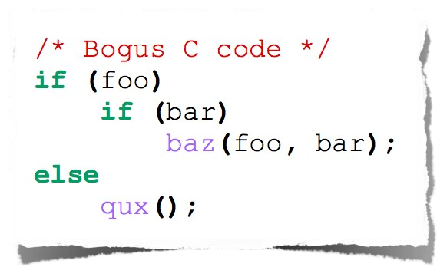
Indentation
Most languages don’t care about indentation
Most humans do
We tend to group similar things together

Slide 14
Hello World
Open a terminal window and type “python”
If on Windows open a Python IDE like IDLE
At the prompt type ‘hello world!’
>>> 'hello world!'
'hello world!'

Slide 15
Python Overview
Programs are composed of modules
Modules contain statements
Statements contain expressions
Expressions create and process objects

Slide 16
The Python Interpreter
Python is an interpreted language
The interpreter provides an interactive environment to play with the language
Results of expressions are printed on the screen
>>> 3 + 7
10
>>> 3 < 15
True
>>> 'print me' 'print me'
>>> print 'print me' print me
>>>

Slide 17
The print Statement
Elements separated by commas print with a space between them
A comma at the end of the statement (print ‘hello’,) will not print a newline character
>>> print 'hello' hello
>>> print 'hello', 'there' hello there

Slide 18
Documentation
The ‘#’ starts a line comment
>>> 'this will print'
'this will print'
>>> #'this will not'
>>>

Slide 19
Variables
Are not declared, just assigned
The variable is created the first time you assign it a value
Are references to objects
Type information is with the object, not the reference
Everything in Python is an object

Slide 20
Everything is an object
Everything means everything, including functions and classes (more on this later!)
Data type is a property of the object and not of the variable
>>> x = 7
>>> x 7
>>> x = 'hello'
>>> x
'hello'
>>>

Slide 21
Basic operations
Assignment:
– size = 40
– a = b
Numbers
integer, float
complex numbers: 1j+3, abs(z)
Strings
'hello world', 'it\'s hot'
"bye world"
= c = 3

Slide 22
String operations
concatenate with + or neighbours
word = 'Help' + x
word = 'Help' 'a'
subscripting of strings
– 'Hello'[2] → 'l'
– slice: 'Hello'[1:2] → 'el'
word[-1] → last character
len(word) → 5
– immutable: cannot assign to subscript

Slide 23
Numbers: Integers
Integer – the equivalent of a C long
Long Integer – an unbounded integer value.
>>> 132224
132224
>>> 132323 ** 2 17509376329L
>>>

Slide 24
Numbers: Floating Point
int(x) converts x to an integer
float(x) converts x to a floating point
The interpreter shows a lot of digits
>>> 1.23232
1.2323200000000001
>>> print 1.23232
1.23232
>>> 1.3E7 13000000.0
>>> int(2.0) 2
>>> float(2) 2.0

Slide 25
Numbers: Complex
Built into Python
Same operations are supported as integer and float
>>> x = 3 + 2j
>>> y = -1j
>>> x + y (3+1j)
>>> x * y (2-3j)

Slide 26
Numbers are immutable
x 4.5
y
>>> x = 4.5
>>> y = x
>>> y += 3
x y
4.5
7.5
>>> x 4.5
>>> y 7.5

Slide 27
String Literals
Strings are immutable
There is no char type like in C++ or Java
• + is overloaded to do concatenation
>>> x = 'hello'
>>> x = x + ' there'
>>> x
'hello there'

Slide 28
String Literals: Many Kinds
Can use single or double quotes, and three double quotes for a multi-line string
>>> 'I am a string' 'I am a string'
>>> "So am I!"
'So am I!'
>>> s = """And me too! though I am much longer than the others :)"""
'And me too!\nthough I am much longer\nthan the others :)‘
>>> print s And me too!
though I am much longer
than the others :)‘ Priyanka Pradhan
28

Slide 29
Substrings and Methods
len(String) – returns the number of characters in the String
>>> s = '012345'
>>> s[3] '3'
>>> s[1:4] '123'
>>> s[2:] '2345'
>>> s[:4] '0123'
>>> s[-2] '4'
str(Object) – returns a String representation of the Object
>>> len(x) 6
>>> str(10.3) '10.3'

Slide 30
String Formatting
Similar to C’s printf
<formatted string> % <elements to insert>
Can usually just use %s for everything, it will convert the object to its String representation.
>>> "One, %d, three" % 2 'One, 2, three'
>>> "%d, two, %s" % (1,3)
'1, two, 3'
>>> "%s two %s" % (1, 'three') '1 two three'
>>>

Slide 31
Do nothing
pass does nothing
syntactic filler
while 1: pass

Slide 32
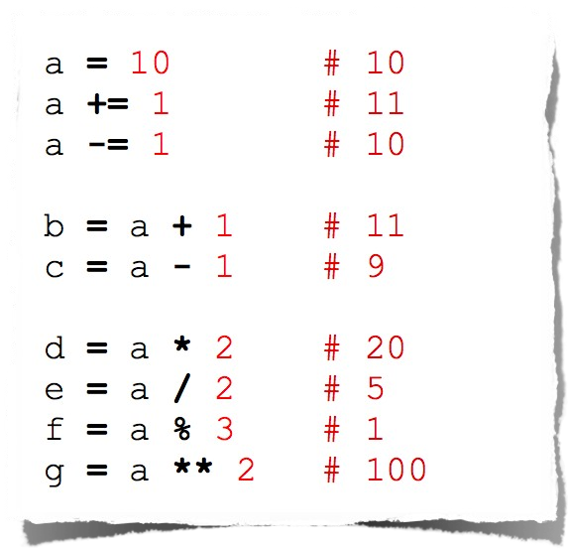
Operators
Arithmetic

Slide 33
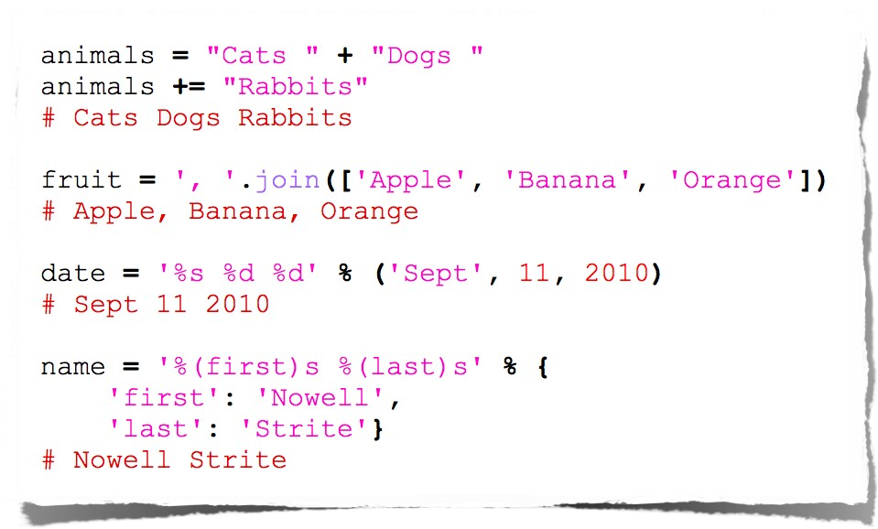
String Manipulation

Slide 34
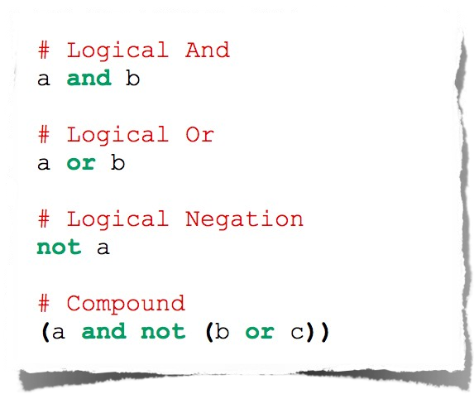
Logical Comparison

Slide 35
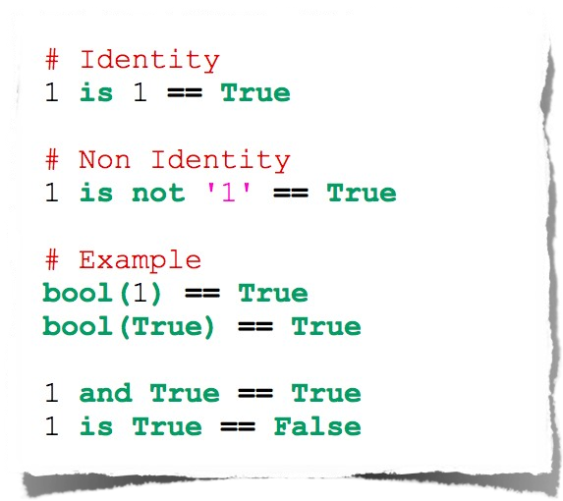
Identity Comparison

Slide 36
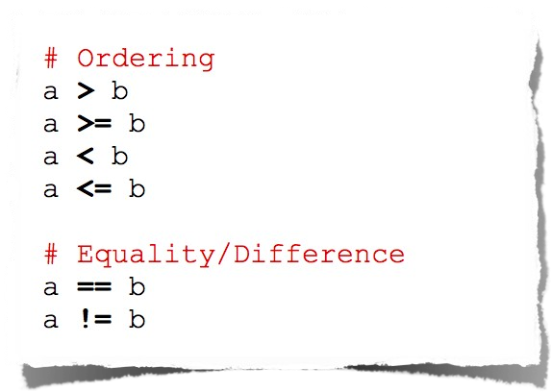
Arithmetic Comparison

Slide 37
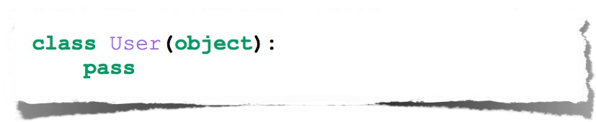
Class Declaration

Slide 38
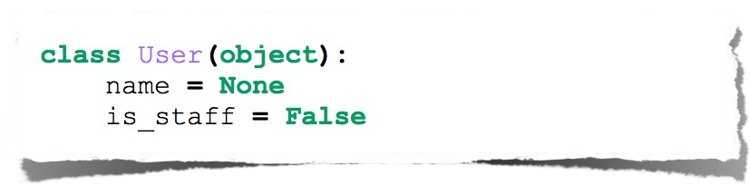
Class Attributes
Attributes assigned at class declaration should always be immutable

Slide 39
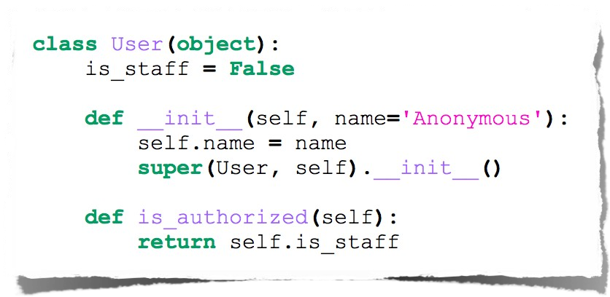
Class Methods

Slide 40
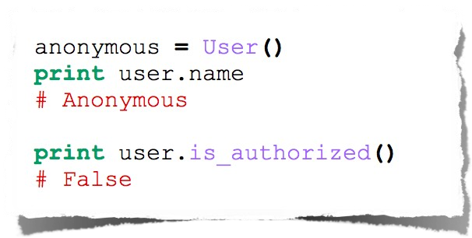
Class Instantiation & Attribute Access

Slide 41
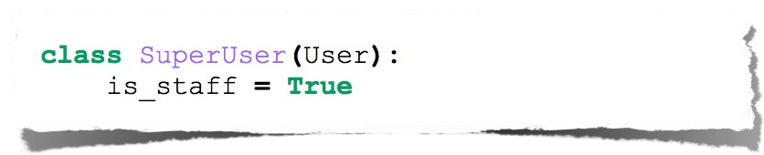
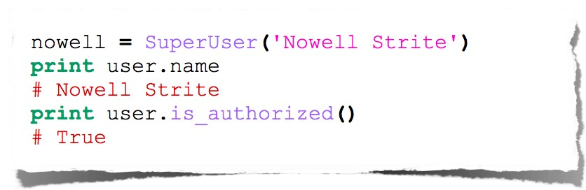
Class Inheritance

Slide 42
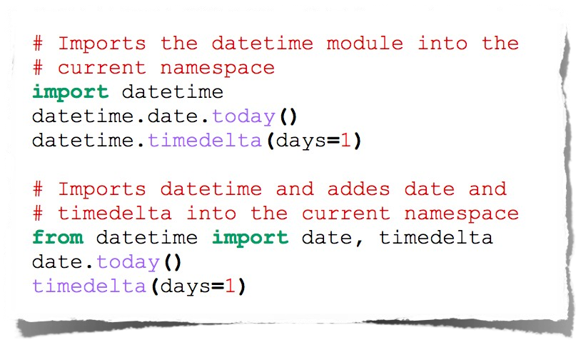
Imports

Slide 43
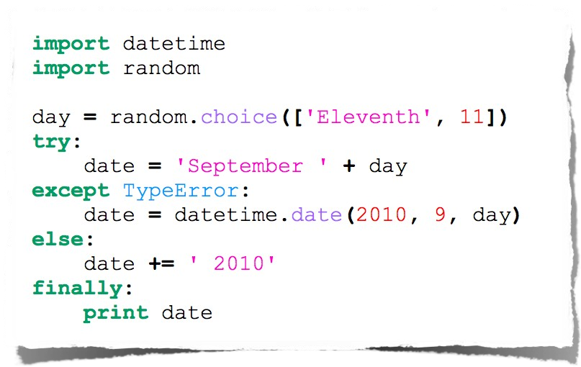
Error Handling

Slide 44
Lists
Ordered collection of data
Data can be of different types
Lists are mutable
Issues with shared references and mutability
Same subset operations as Strings
>>> x = [1,'hello', (3 + 2j)]
>>> x
[1, 'hello', (3+2j)]
>>> x[2] (3+2j)
>>> x[0:2]
[1, 'hello']

Slide 45
List
lists can be heterogeneous
– a = ['spam', 'eggs', 100, 1234, 2*2]
Lists can be indexed and sliced:
– a[0] → spam
– a[:2] → ['spam', 'eggs']
Lists can be manipulated
– a[2] = a[2] + 23
– a[0:2] = [1,12]
– a[0:0] = []
– len(a) → 5
Priyanka Pradhan
45

Slide 46
List methods
append(x)
extend(L)
append all items in list (like Tcl lappend)
insert(i,x)
remove(x)
pop([i]), pop()
create stack (FIFO), or queue (LIFO) → pop(0)
index(x)
return the index for value x

Slide 47
Contd…
count(x)
how many times x appears in list
sort()
sort items in place
reverse()
reverse list

Slide 48
Lists: Modifying Content
x[i] = a reassigns the ith element to the value a
Since x and y point to the same list object, both are changed
The method append
also modifies the list
>>> x = [1,2,3]
>>> y = x
>>> x[1] = 15
>>> x [1, 15, 3]
>>> y [1, 15, 3]
>>> x.append(12)
>>> y
[1, 15, 3, 12]

Slide 49
Lists: Modifying Contents
>>> x = [1,2,3]
>>> y = x
>>> z = x.append(12)
>>> z == None True
>>> y
[1, 2, 3, 12]
>>> x = x + [9,10]
>>> x
[1, 2, 3, 12, 9, 10]
>>> y
[1, 2, 3, 12]
The method append modifies the list and returns None
List addition (+) returns a new list
Priyanka Pradhan>>>
49

Slide 50
Strings share many features with lists
>>> smiles = "C(=N)(N)N.C(=O)(O)O"
>>> smiles[0] 'C'
>>> smiles[1] '('
>>> smiles[-1] 'O'
>>> smiles[1:5] '(=N)'
>>> smiles[10:-4] 'C(=O)'

Slide 51
String Methods: find, split
smiles = "C(=N)(N)N.C(=O)(O)O"
>>> smiles.find("(O)") 15
>>> smiles.find(".")
9
>>> smiles.find(".", 10)
-1
>>> smiles.split(".") ['C(=N)(N)N', 'C(=O)(O)O']
>>>

Slide 52
String operators: in, not in
if "Br" in “Brother”:
print "contains brother“
email_address = “clin”
if "@" not in email_address: email_address += "@brandeis.edu“

Slide 53
String Method: “strip”, “rstrip”, “lstrip” are ways to
remove whitespace or selected characters
>>> line = " # This is a comment line \n"
>>> line.strip()
'# This is a comment line'
>>> line.rstrip()
# This is a comment line'
>>> line.rstrip("\n")
# This is a comment line '
>>>

Slide 54
More String methods
email.startswith(“c") endswith(“u”) True/False
>>> "%s@brandeis.edu" % "clin" 'clin@brandeis.edu'
>>> names = [“Ben", “Chen", “Yaqin"]
>>> ", ".join(names) ‘Ben, Chen, Yaqin‘
>>> “chen".upper() ‘CHEN'

Slide 55
“\” is for special characters
\n -> newline
\t -> tab
\\ -> backslash
...
But Windows uses backslash for directories!
filename = "M:\nickel_project\reactive.smi" # DANGER! filename = "M:\\nickel_project\\reactive.smi" # Better! filename = "M:/nickel_project/reactive.smi" # Usually works

Slide 56
Tuples
Tuples are immutable
versions of lists
One strange point is the format to make a tuple with one element:
‘,’ is needed to differentiate from the mathematical expression (2)
>>> x = (1,2,3)
>>> x[1:]
(2, 3)
>>> y = (2,)
>>> y (2,)
>>>

Slide 57
Tuples and sequences
lists, strings, tuples: examples of sequence
type
tuple = values separated by commas
>>> t = 123, 543, 'bar'
>>> t[0] 123
>>> t
(123, 543, 'bar')

Slide 58
Contd…
Tuples may be nested
>>> u = t, (1,2)
>>> u
((123, 542, 'bar'), (1,2))
Empty tuples: ()
>>> empty = ()
>>> len(empty)
0
Priyanka Pradhan
58

Slide 59
Dictionaries
A set of key-value pairs
Dictionaries are mutable
>>> d = {1 : 'hello', 'two' : 42, 'blah' : [1,2,3]}
>>> d
{1: 'hello', 'two': 42, 'blah': [1, 2, 3]}
>>> d['blah']
[1, 2, 3]
Priyanka Pradhan
59

Slide 60
Contd..
no particular order
delete elements with del
>>> del tel['foo']
keys() method → unsorted list of keys
>>> tel.keys()
['cs', 'lennox', 'hgs']
use has_key() to check for existence
>>> tel.has_key('foo')
0
Priyanka Pradhan
60

Slide 61
Dictionaries: Add/Modify
Entries can be changed by assigning to that entry
>>> d
{1: 'hello', 'two': 42, 'blah': [1, 2, 3]}
>>> d['two'] = 99
>>> d
{1: 'hello', 'two': 99, 'blah': [1, 2, 3]}
Assigning to a key that does not exist adds an entry
>>> d[7] = 'new entry'
>>> d
{1: 'hello', 7: 'new entry', 'two': 99, 'blah': [1, 2, 3]}

Slide 62
Dictionaries: Deleting Elements
The del method deletes an element from a dictionary
>>> d
{1: 'hello', 2: 'there', 10: 'world'}
>>> del(d[2])
>>> d
{1: 'hello', 10: 'world'}

Slide 63
Copying Dictionaries and Lists
The built-in list function will copy a list
The dictionary has a method called copy
>>> l1 = [1]
>>> l2 = list(l1)
>>> l1[0] = 22
>>> l1 [22]
>>> l2 [1]
>>> d = {1 : 10}
>>> d2 = d.copy()
>>> d[1] = 22
>>> d
{1: 22}
>>> d2
{1: 10}

Slide 64
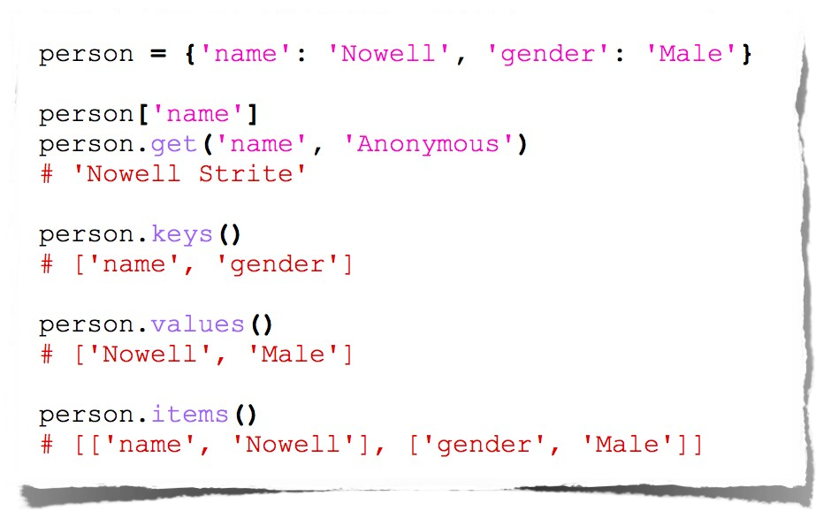
Dictionary Methods

Slide 65
Data Type Summary
Lists, Tuples, and Dictionaries can store any type (including other lists, tuples, and dictionaries!)
Only lists and dictionaries are mutable
All variables are references

Slide 66
Contd…
Integers: 2323, 3234L
Floating Point: 32.3, 3.1E2
Complex: 3 + 2j, 1j
Lists: l = [ 1,2,3]
Tuples: t = (1,2,3)
Dictionaries: d = {‘hello’ : ‘there’, 2 : 15}

Slide 67
Modules
collection of functions and variables, typically in scripts
definitions can be imported
file name is module name + .py
e.g., create module fibo.py
def fib(n): # write Fib. series up to n
...
def fib2(n): # returnPriFyanikba P.radsheanries up to n
67

Slide 68
Contd…
function definition + executable statements
executed only when module is imported
modules have private symbol tables
avoids name clash for global variables
accessible as module.globalname
can import into name space:
>>> from fibo import fib, fib2
>>> fib(500)
can import all names defined by module:
>>> from fibo import *

Slide 69
Input
The raw_input(string) method returns a line of user input as a string
The parameter is used as a prompt
The string can be converted by using the conversion methods int(string), float(string), etc.

Slide 70
Input: Example
print “enter your name?" name = raw_input("> ")
print "When were you born?" birthyear = int(raw_input("> "))
print "Hi %s! You are %d years old!" % (name, 2017 - birthyear)
~: python input.py What's your name?
> Michael
What year were you born?
>1980
Hi Michael! YoPuriyaanrkea P3ra1dhaynears old!
70

Slide 71
Booleans
0 and None are false
Everything else is true
True and False are aliases for 1 and 0 respectively

Slide 72
Boolean Expressions
Compound boolean expressions short circuit
and and or return one of the elements in the expression
Note that when None is returned the interpreter does not print anything
>>> True and False False
>>> False or True True
>>> 7 and 14
14
>>> None and 2
>>> None or 2 2

Slide 73
No Braces
Python uses indentation instead of braces to determine the scope of expressions
All lines must be indented the same amount to be part of the scope (or indented more if part of an inner scope)
This forces the programmer to use proper indentation since the indenting is part of the program!

Slide 74
If Statements
import math x = 30
if x <= 15 : y = x + 15
elif x <= 30 : y = x + 30
else :
y = x print ‘y = ‘,
print math.sin(y)
>>> import ifstatement y = 0.999911860107
>>>
In interpreter
In file ifstatement.py

Slide 75
While Loops
>>> import whileloop 1
2
3
4
5
6
7
8
9
>>>
x = 1
while x < 10 : print x
x = x + 1
In whileloop.py
In interpreter

Slide 76
Loop Control Statements
break
Jumps out of the closest enclosing loop
continue
Jumps to the top of the closest enclosing loop
pass
Does nothing, empty statement placeholder

Slide 77
The Loop Else Clause
The optional else clause runs only if the loop exits normally (not by break)
x = 1
while x < 3 : print x
x = x + 1
else:
print 'hello'
~: python whileelse.py 1
2
hello
Run from the command line
In whileelse.py

Slide 78
The Loop Else Clause
x = 1
while x < 5 : print x
x = x + 1 break
else :
print 'i got here'
~: python whileelse2.py 1
whileelse2.py

Slide 79
For Loops
for x in [1,7,13,2] : print x
for x in range(5) : print x
forloop1.py
forloop2.py
~: python forloop2.py 0
1
2
3
4
~: python forloop1.py 1
7
13
2
range(N) generatesPraiyalniksatPoradfhannumbers [0,1, …, n-1]
79

Slide 80
For Loops
For loops also may have the optional else clause
for x in range(5): print x
break else :
print 'i got here'
~: python elseforloop.py 1
elseforloop.py

Slide 81
Function Basics
def max(x,y) : if x < y :
return x else :
return y
>>> import functionbasics
>>> max(3,5) 5
>>> max('hello', 'there') 'there'
>>> max(3, 'hello') 'hello'
functionbasics.py

Slide 82
Functions are first class objects
Can be assigned to a variable
Can be passed as a parameter
Can be returned from a function
Functions are treated like any other variable in Python, the def statement simply assigns a function to a variable

Slide 83
Function names are like any variable
>>> x = 10
>>> x 10
>>> def x () :
... print 'hello'
>>> x
<function x at 0x619f0>
>>> x()
hello
>>> x = 'blah'
>>> x
'blah'
Functions are objects
The same reference rules hold for them as for other objects

Slide 84
Functions as Parameters
def foo(f, a) : return f(a)
def bar(x) : return x * x
>>> from funcasparam import *
>>> foo(bar, 3)
9
funcasparam.py
Note that the function foo takes two parameters and applies the first as a function with the second as its parameter

Slide 85
Higher-Order Functions
map(func,seq) – for all i, applies func(seq[i]) and returns the corresponding sequence of the calculated results.
>>> from highorder import *
>>> lst = range(10)
>>> lst [0,1,2,3,4,5,6,7,8,9]
>>> map(double,lst) [0,2,4,6,8,10,12,14,16,18]
def double(x): return 2*x
highorder.py

Slide 86
Higher-Order Functions
filter(boolfunc,seq) – returns a sequence containing all those items in seq for which boolfunc is True.
>>> from highorder import *
>>> lst = range(10)
>>> lst [0,1,2,3,4,5,6,7,8,9]
>>> filter(even,lst) [0,2,4,6,8]
def even(x):
return ((x%2 == 0)
highorder.py

Slide 87
Higher-Order Functions
reduce(func,seq) – applies func to the items of seq, from left to right, two-at-time, to reduce the seq to a single value.
>>> from highorder import *
>>> lst = [‘h’,’e’,’l’,’l’,’o’]
>>> reduce(plus,lst) ‘hello’
def plus(x,y): return (x + y)
highorder.py

Slide 88
Functions Inside Functions
Since they are like any other object, you can have functions inside functions
def foo (x,y) : def bar (z) :
return z * 2 return bar(x) + y
>>> from funcinfunc import *
>>> foo(2,3) 7
funcinfunc.py

Slide 89
Functions Returning Functions
def foo (x) : def bar(y) :
return x + y return bar
# main
f = foo(3) print f print f(2)
~: python funcreturnfunc.py
<function bar at 0x612b0> 5
funcreturnfunc.py

Slide 90
Parameters: Defaults
Parameters can be assigned default values
They are overridden if a parameter is given for them
The type of the default doesn’t limit the type of a parameter
>>> def foo(x = 3) :
... print x
...
>>> foo() 3
>>> foo(10) 10
>>> foo('hello') hello

Slide 91
Parameters: Named
Call by name
Any positional arguments must come before named ones in a call
>>> def foo (a,b,c) :
... print a, b, c
...
>>> foo(c = 10, a = 2, b = 14) 2 14 10
>>> foo(3, c = 2, b = 19) 3 19 2

Slide 92
Anonymous Functions
A lambda expression returns a function object
The body can only be a simple expression, not complex statements
>>> f = lambda x,y : x + y
>>> f(2,3) 5
>>> lst = ['one', lambda x : x * x, 3]
>>> lst[1](4) 16

Slide 93
Modules
The highest level structure of Python
Each file with the py suffix is a module
Each module has its own namespace

